Slide 1

Introduction to
Sarah Bowden, Ph.D.
16 June 2016

Slide 2
What is R?
Statistical programming environment
Programming language

Slide 3
Why should you use R?
Open source (non-proprietary)
Constantly improved and added to by a large community of users
Code-sharing and ease of collaboration

Slide 4

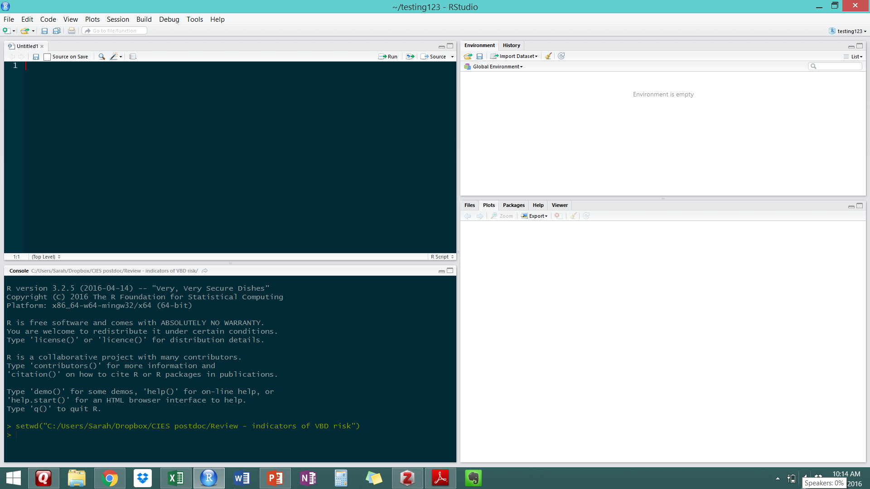
GUI: Graphical user interface
Script
Environment
Console
Plots/Help

Slide 5
Writing + executing your code
Always start a new script for a new project
Annotate, annotate, annotate! (see next slide)
Execute from your script 2 ways:
Highlight line(s) of code + hit Run
Highlight line(s) of code and hit Ctrl+Enter

Slide 6
Basic functionality: code annotation
Use one or more # to add comments (annotate) your code
Title your script
Include author(s), date started and/or last edited date
Use this to remind your (future) self or explain to someone else what a line or chunk of code is doing
When you’re learning R, you can never annotate too much
Exercise:
Start your own new script to use throughout this tutorial
Annotate it: give it a title, add your name and today’s date

Slide 7
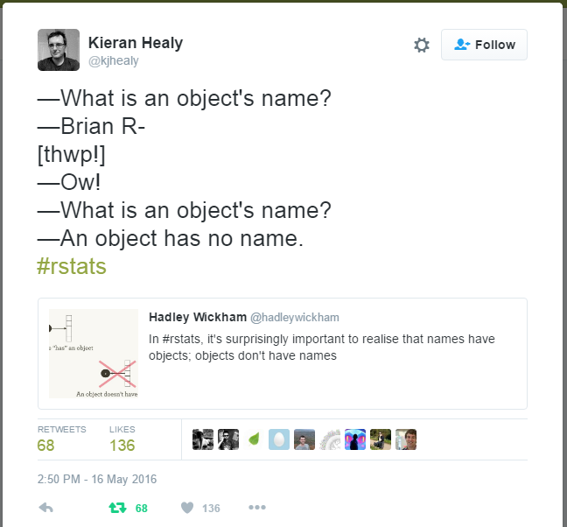
Basic functionality: assignments
In R, we’re always working with ‘objects’
Objects can be single numbers
Vectors, matrices, lists, data frames
We need to assign these objects to name to more easily access them
Assignments use <- to associate an object with a name
Exercise:
Pick four numbers and assign each of them to a different name of your choice
*everything in R is CASE SENSITIVE
So myvariable =/= MyVariable

Slide 8
Basic functionality: math
R has a wide range of mathematical functionally
Addition, subtraction, multiplication, division
Exponents, logs, square roots
Linear algebra (manipulation of vectors and matrices)
Built-in summary functions
Build your own functions
Exercise:
Write a line of code for each math function we reviewed using the objects you previously assigned
Make sure you’re comfortable with the syntax of each of these mathematical functions
(P.S. – Are you still annotating your code?)

Slide 9
Basic functionality: vectors
R uses multiple different data structures that are assigned to names
vectors, matrices, lists, data frames
Vectors are the most basic = collection of numbers in a specific order
Exercise:
Create a two vectors of the same length and write a few lines of code to manipulate them individually and together
Create a new vector consisting of your two previous vectors

Slide 10
Basic functionality: sequences + repetitions
Sometimes we need to created a vector that is a sequence of numbers or the same number repeated several times
Exercise:
Create a sequence that contains 250 numbers between 6 and 15
Create a vector that repeats that sequence 8 times
Add a sequence of numbers from 1 to 10 to the end of the previous vector

Slide 11
If you want to learn more…
R code school http://tryr.codeschool.com/
Introduction to R (Venables and Smith) https://cran.r-project.org/doc/manuals/R-intro.pdf
The R book (Crawley 2009) – available @ Cary library

Slide 12
Working with your own data

Slide 13
Entering + formatting your data
Standard: Excel spreadsheet
One table per sheet/file
Short, descriptive column names (no spaces)
Camel-case: VariablesNamedLikeThis
Period-case: variables.named.like.this
Snake-case: variables_named_like_this
Column names can’t start with a number

Slide 14
Metadata requirements
Variable (column name)
Variable description
Units
Variable type (continuous, categorical, binary, logical/Boolean (True/False), count)
Save 1st sheet (data only) as .csv
Save entire worksheet (data + metadata) as .xlsx
Give BOTH files the SAME NAME

Slide 15
Getting your data into R
Importing data into R is called “reading”
Several functions for reading in data, but most universal is read.csv()
Set working directory to wherever your data file(s) are located
Use read.csv() to specify file name + presence of headers (i.e., column names)
Assign each file you read in to a unique name

Slide 16
Manipulating your data
Inspect your data set
Calculate summary statistics
Indexing – splitting your data into defined subsets
A peek at data viz – histograms + box-and-whisker plots

Slide 17
Exercise: writing your own code
Working from the original data file, subset the data by sex
Report the number of females and males for each species
Report the mean +/- standard deviation of body length for each sex
Create both a histogram and boxplot of body length for each sex
Which sex has more body length outliers?
Do female outliers tend to be much longer or much shorter than average?
Do male outliers tend to be much longer or much shorter than average?

Slide 18
Future workshops
Data visualization (June 30) – how to plot different types of data; customized plotting in R
Basic statistical tests (July 7) – assumptions, selecting the right test, implementing in R
Reproducible research with Rmarkdown (July 28) – the gold standard for collaborative research
End of summer (August 1-5): individual meetings by appointment
bowdens@caryinstitute.org

